Slide 1


PYTHON
Lecture 6

Slide 2

Today’s Agenda
More On Data Types
The float Type
The complex Type
The bool Type
The str Type

Slide 3
The float Data Type
Python also supports floating-point real values.
Float values are specified with a decimal point
So 2.5 , 3.14 , 6.9 etc are all examples of float data type
Just like double data type of other languages like Java/C , float in Python has a precision of 16 digits

Slide 4
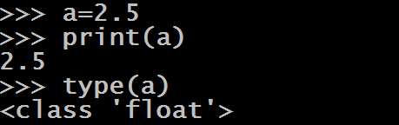

Some Examples

Slide 5
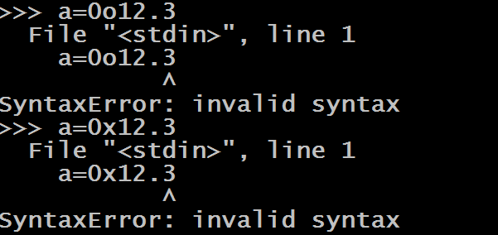
Some Important Points About float
For float , we can only assign values in decimal number system and not in binary , octal or hexadecimal number system.

Slide 6

Some Important Points About float
Float values can also be represented as exponential values
Exponential notation is a scientific notation which is represented using e or E followed by an integer and it means to the power of 10

Slide 7
The complex Data Type
Complex numbers are written in the form, x + yj, where x is the real part and y is the imaginary part.
For example: 4+3j , 12+1j etc
The letter j is called unit imaginary number.
It denotes the value of √-1 , i.e j² denotes -1

Slide 8
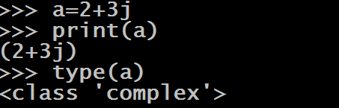
An Example

Slide 9
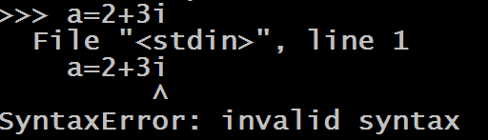
Some Important Points About complex Data Type
For representing the unit imaginary number we are only allowed to use the letter j (both upper and lower case are allowed).
Any other letter if used will generate error

Slide 10
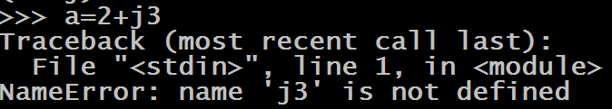
Some Important Points About complex Data Type
The letter j , should only appear in suffix , not in prefix

Slide 11

Some Important Points About complex Data Type
The real and imaginary parts are allowed to be integers as well as floats

Slide 12

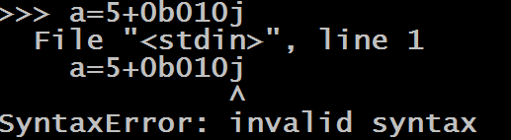
Some Important Points About complex Data Type
The real part can be specified in any int form i.e. decimal , binary , octal or hexadecimal but the imaginary part should only be in decimal form

Slide 13
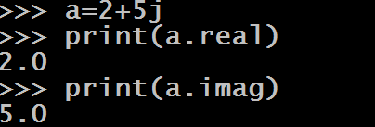
Some Important Points About complex Data Type
We can display real and imaginary part separately by using the attributes of complex types called “real” and “imag”.
Don’t think real and imag are functions , rather they are attributes/properties of complex data type

Slide 14
The bool Data Type
In Python , to represent boolean values we have bool data type.
The bool data type can be one of two values, either True or False.
We use Booleans in programming to make comparisons and to control the flow of the program.

Slide 15


Some Examples

Slide 16
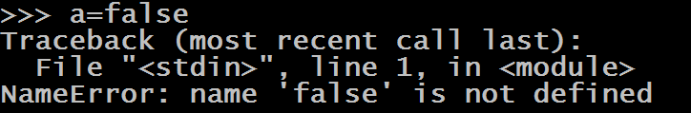
Some Important Points About bool
True and False are keywords , so case sensitivity must be remembered while assigning them otherwise Python will give error

Slide 17
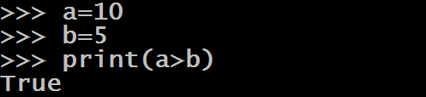
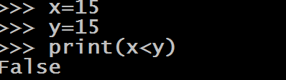
Some Important Points About bool
All test conditions in Python return the result as bool which could be either True or False

Slide 18
Some Important Points About bool
To understand the next point , try to guess the output of the following:
a=True
b=False
c=a+b
print(c)
Output:
1
a=True
b=True
c=a+b
print(c)
Output:
2
a=False
b=False
c=a+b
print(c)
Output:
0
The above outputs make it clear that internally Python stores True and False as integers with the value 1 and 0 respectively

Slide 19
The str Data Type
Just like any other language , in Python also a String is sequence of characters.
Python does not have a char data type, unlike C/C++ or Java
We can use single quotes or double quotes to represent strings.
However Python recommends to use single quotes

Slide 20



Some Examples
The data type used by Python internally for storing Strings is
str

Slide 21
Some Important Points About Strings
Unlike C language , Python does not uses ASCII number system for characters . It uses UNICODE number system
UNICODE is a number system which supports much wider range of characters compared to ASCII
As far as Python is concerned , it uses UNICODE to support 65536 characters with their numeric values ranging from 0 to 65535 which covers almost every spoken language in the world like English , Greek , Spanish , Chinese , Japanese etc

Slide 22
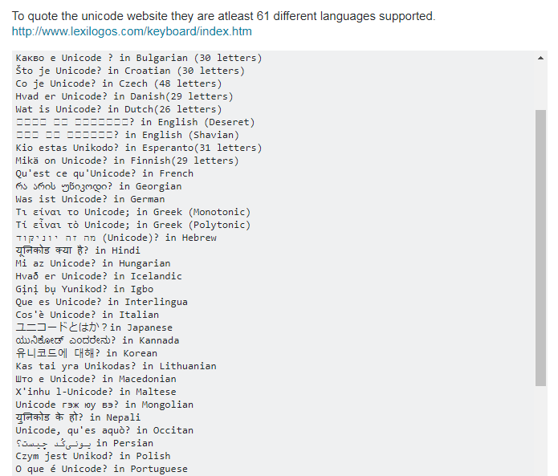
Some Important Points About Strings

Slide 23


Some Important Points About Strings
Whenever we display a string value directly on Python’s shell i.e. without using the function print(), Python’s shell automatically encloses it in single quotes
However this does not happen when we use print() function to print a string value

Slide 24
Some Important Points About Strings
If a string starts with double quotes , it must end with double quotes only .
Similarly if it starts with single quotes , it must end with single quotes only.
Otherwise Python will generate error

Slide 25
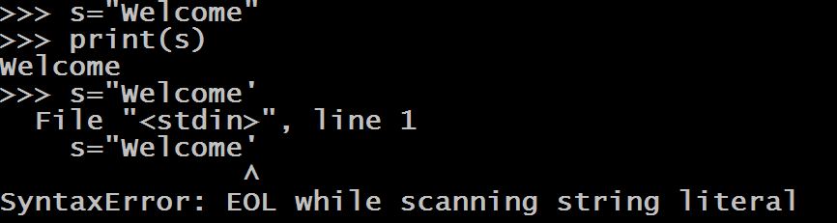
Some Important Points About Strings

Slide 26
Some Important Points About Strings
If the string contains single quotes in between then it must be enclosed in double quotes and vice versa.
For example:
To print Sachin's Python Classes , we would write:
msg= " Sachin's Python Classes "
Similarly to print Capital of "MP" is "Bhopal" ,we would write:
msg='Capital of "MP" is "Bhopal" '

Slide 27


Some Important Points About Strings

Slide 28
Some Important Points About Strings
How will you print Let's learn "Python" ?
"Let's learn "Python" "
'Let's learn "Python" '
NONE!
Both will give error.
Correct way is to use either triple single quotes or triple
double quotes or escape sequence character \
msg=' ' 'Let's learn "Python" ' ' '
OR
msg='Let\'s learn "Python" '

Slide 29
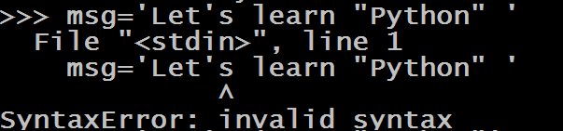
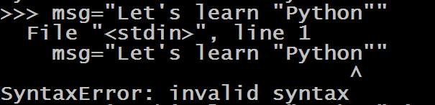
Some Important Points About Strings

Slide 30



Some Important Points About Strings

Slide 31
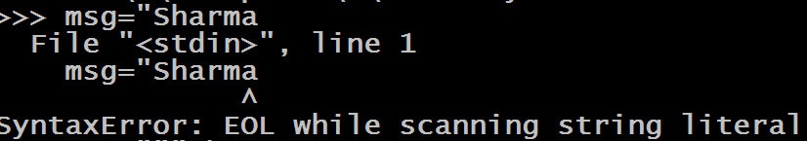
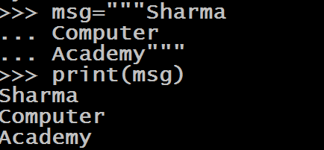
Some Important Points About Strings
Another important use of triple single quotes or triple double quotes is that if our string extends up to more than 1 line then we need to enclose it in triple single quotes or triple double quotes

Slide 32
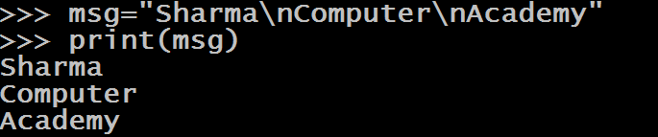
Some Important Points About Strings
We also can do the same thing by using \n , so using triple quotes or triple double quotes is just for improving readability

Slide 33
Accessing Individual Characters In String
In Python, all Strings are stored as individual characters in a contiguous memory location.
Each character in this memory location is assigned an index which begins from 0 and goes up to length -1

Slide 34
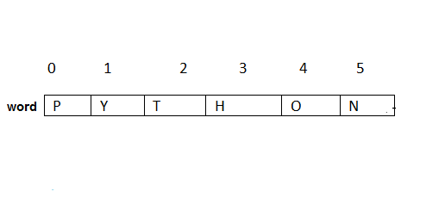
Accessing Individual Characters In String
For example, suppose we write
word=“Python”
Then the internal representation of this will be

Slide 35
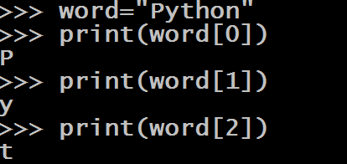
Accessing Individual Characters In String
Now to access individual character we can provide this index number to the subscript operator [ ].

Slide 36
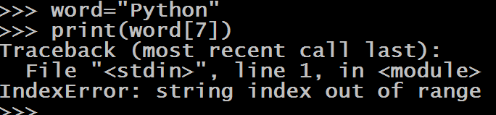
Accessing Individual Characters In String
However if we try to provide an index number beyond the given limit then IndexError exception will arise

Slide 37
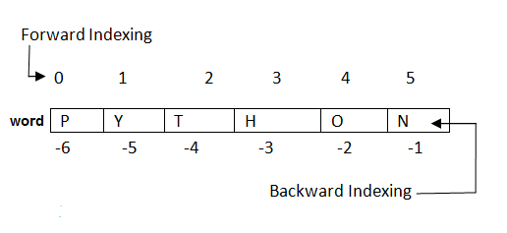
Accessing Individual Characters In String
Not only this , Python even allows negative indexing which begins from the end of the string.
So -1 is the index of last character , -2 is the index of second last character and so on.

Slide 38
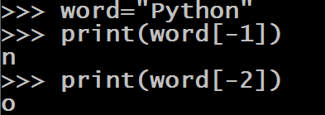
Accessing Individual Characters In String

